Slide 1
Can The Computer Beat the Experts?

Slide 2

Problem Statement

Slide 3
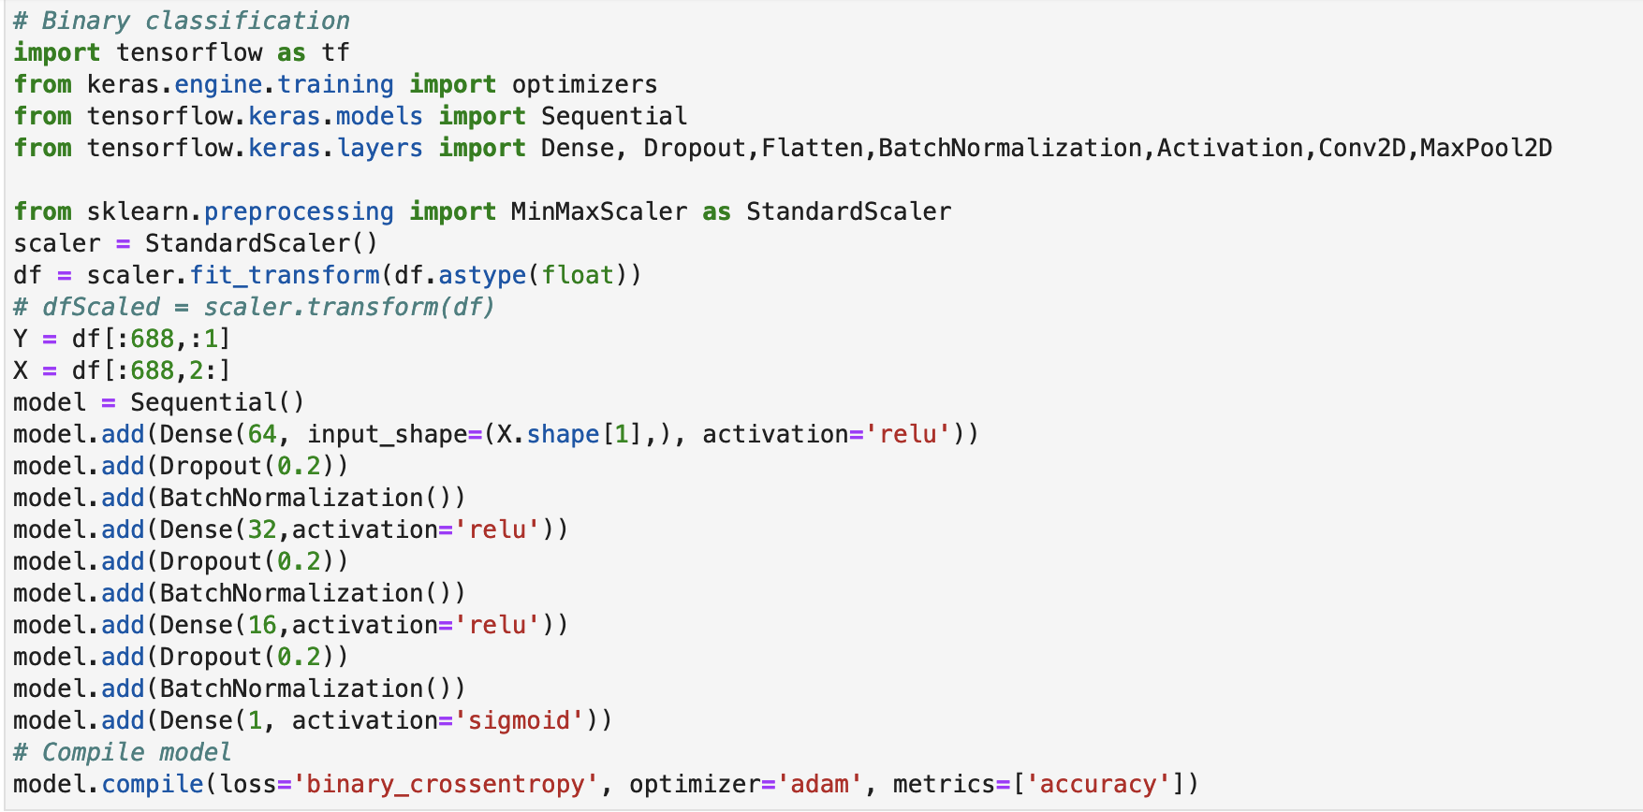
Models

Slide 4

Models Cont

Slide 5
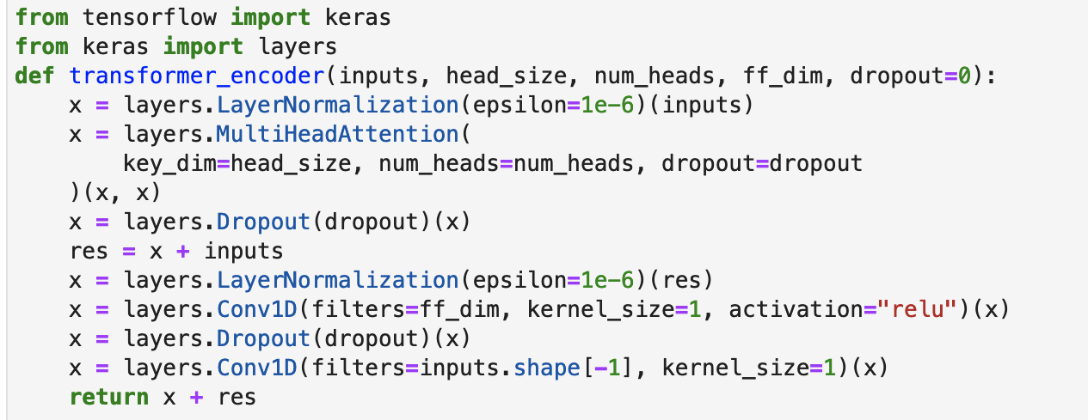
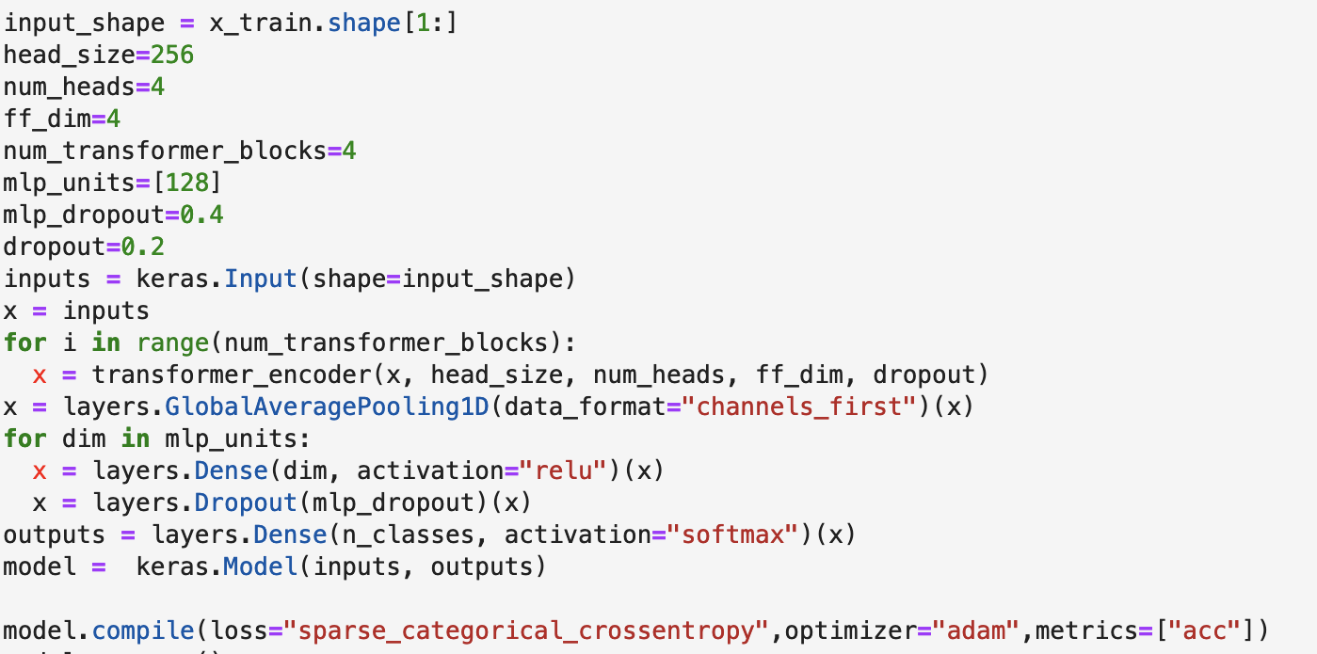
Models Cont

Slide 6
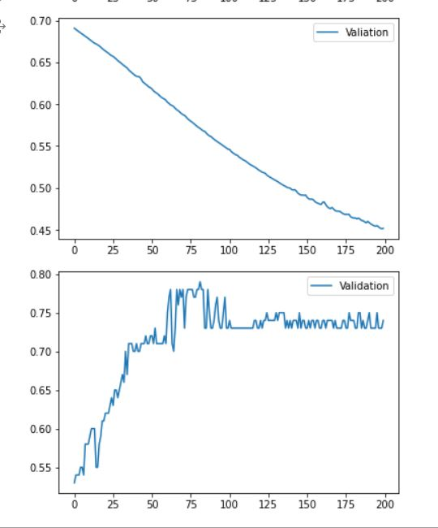
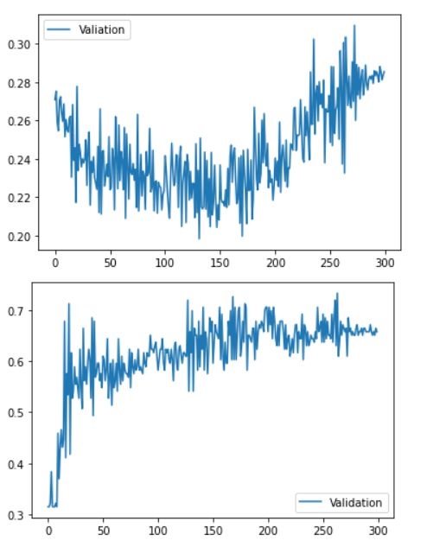
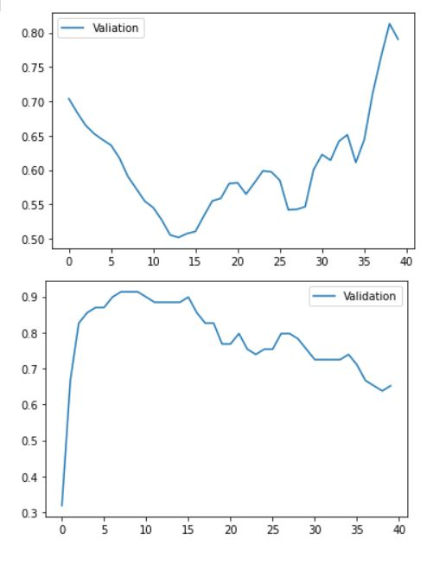
Results
ANN
LSTM
Transformer

